Slide 1

Environmental Policies & Practices

Slide 2

Climate Change
Weather: is the condition of atmosphere at a particular place & time, characterized by parameters like temperature, humidity, rain and wind.
Climate: long term pattern of weather condition of a given area. Or Average weather of an area
Changes occurred in earth’s climate may caused by:
Earth’s internal process
By external forces viz. variation in sunlight intensity or human activities

Slide 3
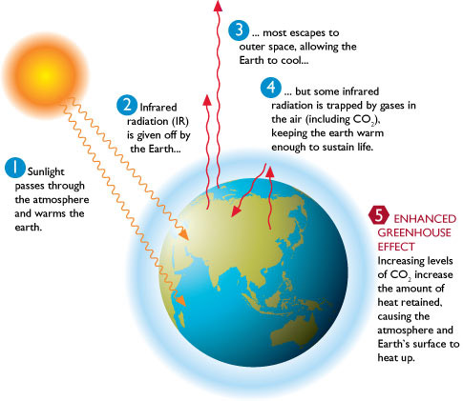
Green House Effect & Global Warming

Slide 4
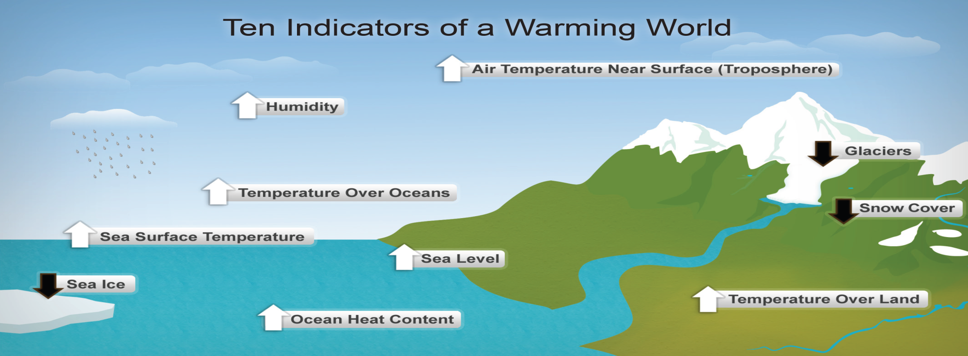
Green House gases Sources
Carbon Dioxide Fossil fuel burning, Industrial process, Deforestation
Methane Livestock, paddy field, Biomass burning, transport
and handling of natural gas, coal mining, sewage or
landfills
CFC’s Refrigeration, Foams, Aerosols, Solvents
NOx Fossil fuel burning, Biomass burning, deforestation,
manure management
Water Vapours
Ozone

Slide 5
Effect of GHG
Increase in global temperature
Stratosphere may get cooler
Melting of glaciers
Greater evaporation rate leads to greater precipitation
Environmental Effects of Global Warming
Weather Extremes
Rise in sea level
Agriculture production
Storms
Adverse effect on human health
Loss of biodiversity

Slide 6
Control Measures of Global Warming
Reduction in use of fossil fuels and CFC’s
Shifting to the renewable energy sources
Use of energy efficient & cleaner production technologies & practices (Inc. nuclear power plant)
Trap and use methane as energy source
Adopt sustainable agriculture
Stabilize population growth
Remove CO₂ by utilizing photosynthetic algae
Reducing deforestation

Slide 7

KYOTO Protocol
The Kyoto Protocol is an international treaty, which extends the 1992 United Nations Framework Convention on Climate Change (UNFCCC) that commits State Parties to reduce greenhouse gases emissions, based on the premise that (a) global warming exists and (b) man-made CO₂ emissions have caused it.
Objective: “stabilization of GHG concentration in the atmosphere at a level that would prevent dangerous anthropogenic interference with the climate system”.

Slide 8
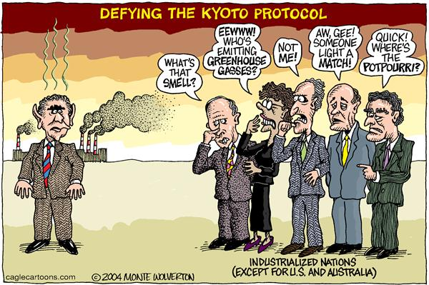
The Kyoto Protocol is ineffective in legally binding the countries that produce more than 40% of total carbon dioxide emissions worldwide. Considering the fact that the emissions of both China and the United States increased in the past decade while the emissions of other countries decreased, it seems as though a legal document is necessary in order to actually make progress in reducing global carbon emissions

Slide 9
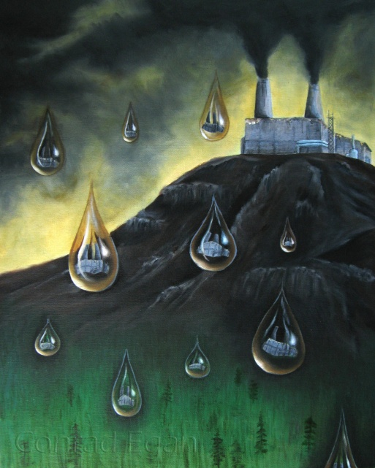
Acid Rain
Refers to the presence of excessive acids in rain water.
A condition in which the natural precipitation becomes acidic after reacting chemically with pollutants in the air
Cause of Acid Rain
Due to increased acidification (wet/dry) in environment by human activities
Rain, snow, dew, fog, mist are wet form
Dust particle are dry form
Major cause includes burning of fossil fuels or other nuclear weapons

Slide 10
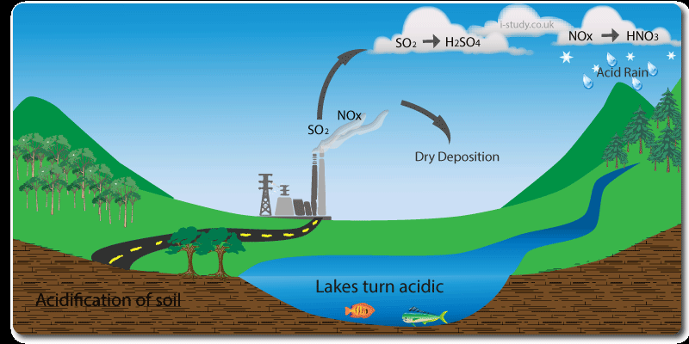
Chemical reactions
2SO₂ + O₂ SO₃
SO₃ + H₂O H₂SO₄
2NO + O₂ 2NO₂
4NO₂ + 2H₂O + O₂ 4HNO₃
Both these acids are strong and when present in the atmosphere, dissolve in water drops to fall on earth as acid rain.
Some natural reason acid rain are volcanic eruption, forest fire etc., which contribute to acidity in rain.

Slide 11
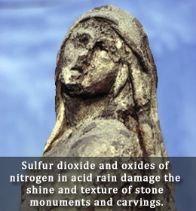
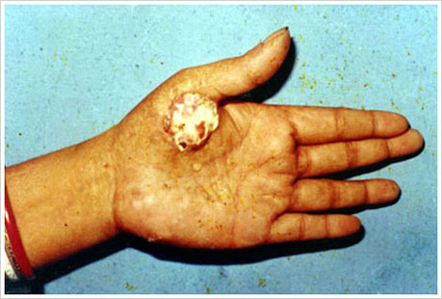
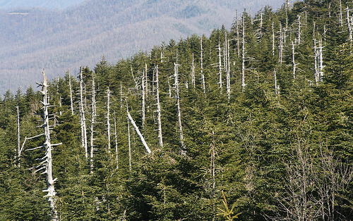
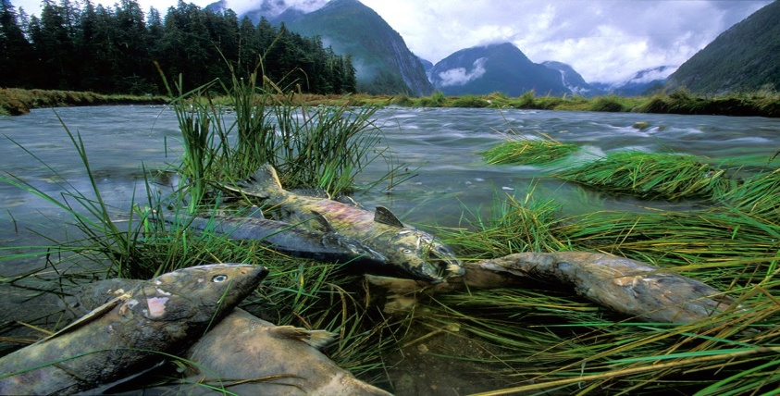
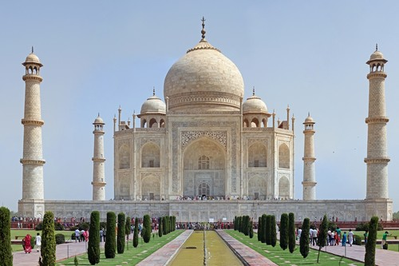
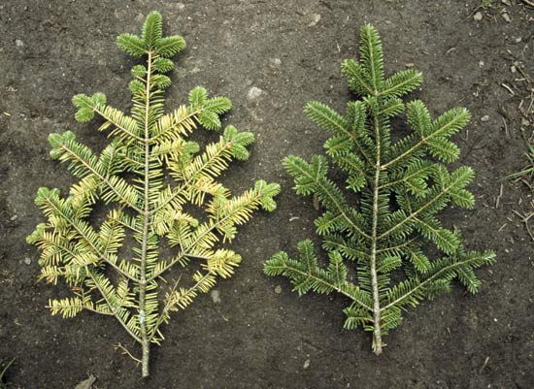
Effect on aquatic ecosystem
Effect on terrestrial ecosystem- damage foliage and weakens trees
Effect on buildings & statues
Damages metals
Use of pollution control equipments
Liming of water bodies
Coating of polymer in
interior of pipes
Effect of Acid Rain
Control of Acid Rain

Slide 12
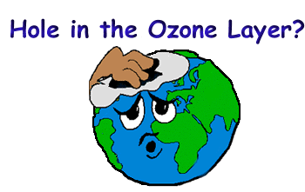
Depletion of ozone layer
This is tri atomic molecule of oxygen (O₃),
Available in stratosphere
Extended from 6 km at the poles and 17 km at the equator.
Ground level O₃ creates respiratory problem.
It is used to kill microorganism during water purification process and as bleaching agent.
If present in stratosphere act as protective layer, where as in troposphere it act as harmful pollutant and is major component of photochemical smog.
Trace of this gas in troposphere can cause damage to human lungs and tissues and also harms plants.
Ozone is also a greenhouse gas.

Slide 13
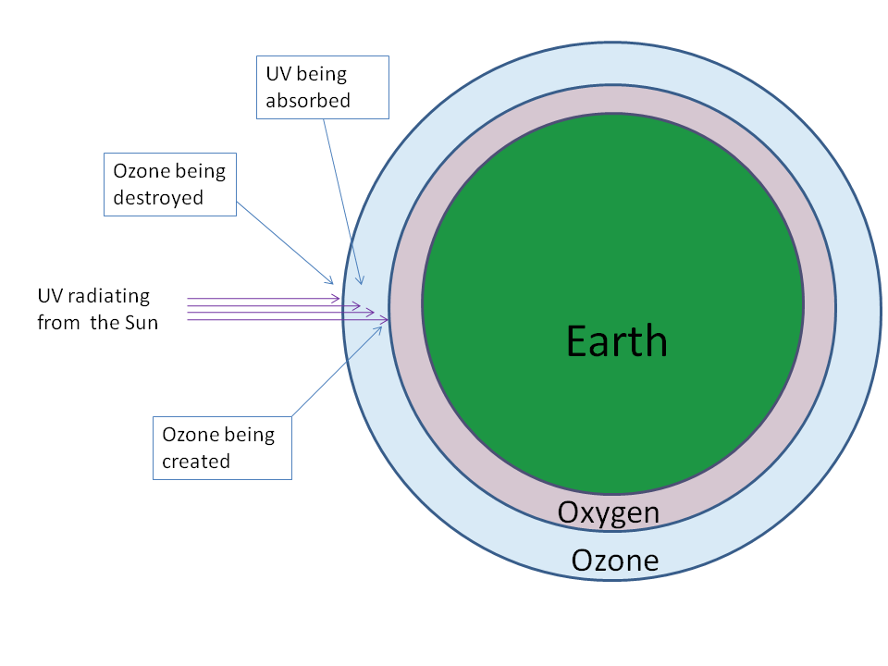
Causes and mechanism for OZONE layer depletion:
The main reason of this is widespread use of CFCs. They are used as coolant in the compressors of refrigerators and air conditioners.
They also used to clean electronic circuits board used in computers, phone etc., and manufacture of foams for mattresses and cushions, disposable Styrofoam cups, packing material, cold storages etc.

Slide 14
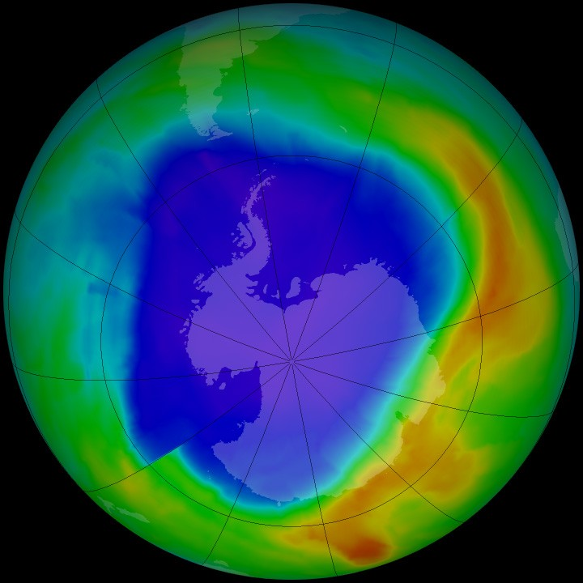
These rise slowly from earth’s surface into the stratosphere.
Under light CFCs break down and release Cl* atoms, which speed up break down of an ozone molecule into O₂ and [O]. One CFC molecule break down 100000 ozone molecule through chain reactions.

Slide 15

Reactions:
CFC UV Cl*
O₂ UV O* + O*
O₂ + O* O₃
O₃ O₂ + O*
Cl* + O* ClO
ClO + ClO Cl-O-O-lC (dimer)
ClOOlC Cl₂ + O₂
Cl₂ Cl* + Cl*

Slide 16
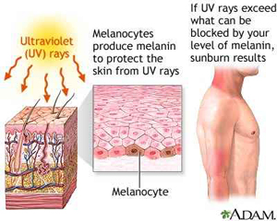
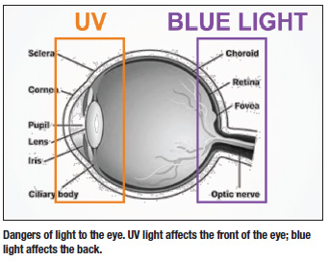
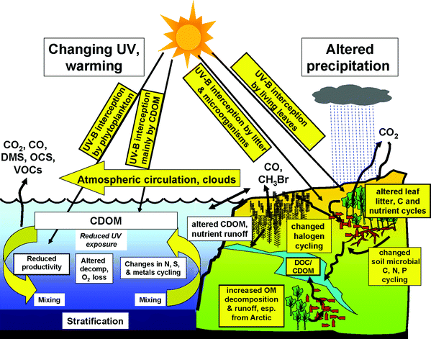
Effects of Ozone layer Depletion
Effect on aquatic ecosystem
Effect on terrestrial ecosystem
Effect on human beings-mutations, cataract, melanin destroying
Effect on climate
Effect on materials
Effect of agriculture- decrement in production

Slide 17
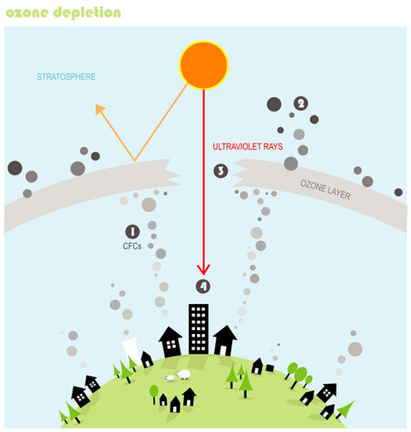
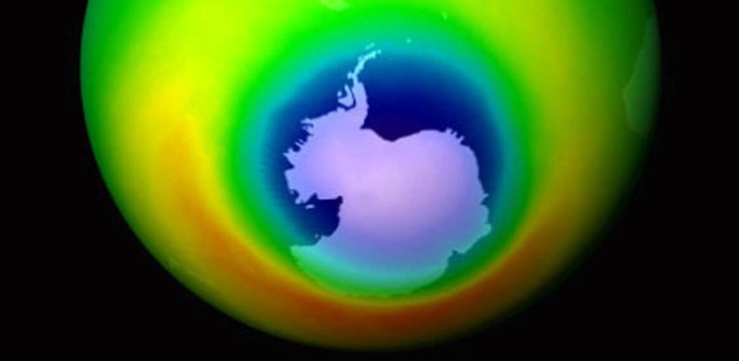
Ozone hole:
The thinning of ozone layer or reduction in concentration of ozone, especially on Antarctic is a major environmental problem.
This thinning is also known as ozone hole.
The British Antarctica revealed decrease in the ozone layer in 1985.

Slide 18
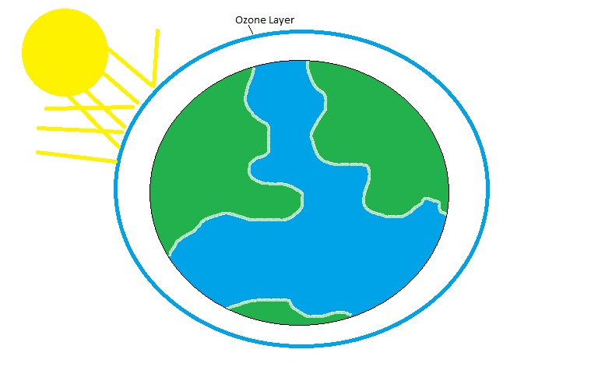
The satellite data indicate that at certain times of the year, level of ozone in stratosphere over Antarctica have decreased by more than 5%.
hole in the ozone layer occur yearly in late September, which is the beginning of the spring in the southern hemisphere.
The hole is of the size of US and it is increasing since discover.

Slide 19
Safety measures:
All over the world, efforts are on to save the ozone layer.
The UN formed a committee which is drafted an agreements that call for a stepwise of reduction of CFCs.
This is called Montreal Protocol came into effect in 1987.
It reflects global efforts towards prevention of ozone depletion.
Some substituent are already available for CFCs, while some others are being developed.
The CFCs can be replaced by hydrocholrofluorocarbons (HCFCs), hydrofluorocarbons (HFCs)**, etc.
16 September is observed as ‘International ozone day’.

Slide 20
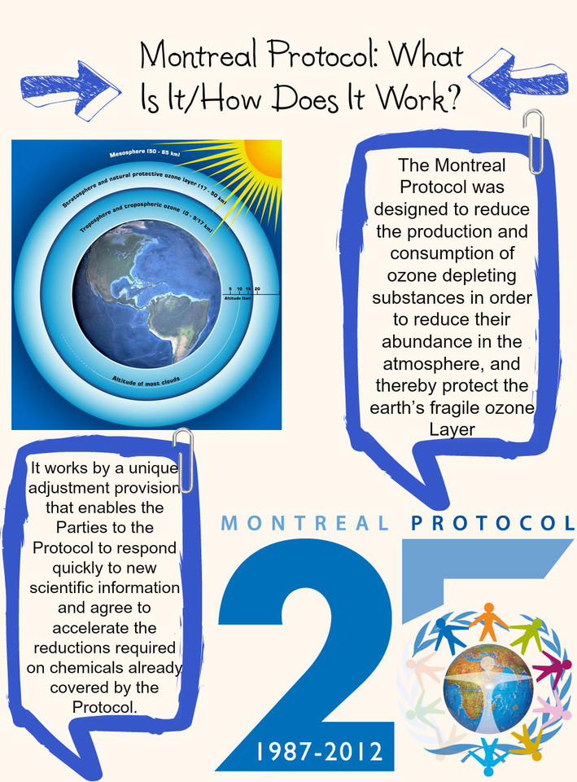
MONTREAL Protocol
On those substance that deplete the ozone layer
Is an international treaty designed to protect the ozone layer by phasing out the production of a number of substance believed to be responsible for ozone degradation
Opened for signature on 16 Sept 1987 & come into force on 1 Jan 1989

Slide 21
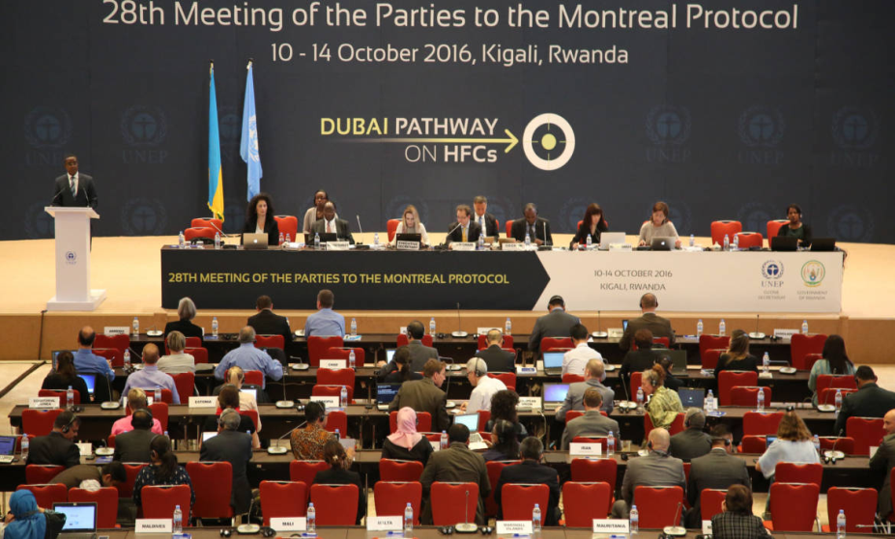
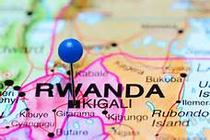
Susan Solomon, an atmospheric chemist at the National Oceanic and Atmospheric Administration (NOAA), proposed that chemical reactions on polar stratospheric clouds (PSCs) in the cold Antarctic stratosphere caused a massive, though localized and seasonal, increase in the amount of chlorine present in active, ozone-destroying forms. The polar stratospheric clouds in Antarctica are only formed when there are very low temperatures, as low as −80 °C, and early spring conditions. In such conditions the ice crystals of the cloud provide a suitable surface for conversion of unreactive chlorine compounds into reactive chlorine compounds, which can deplete ozone easily

Slide 22
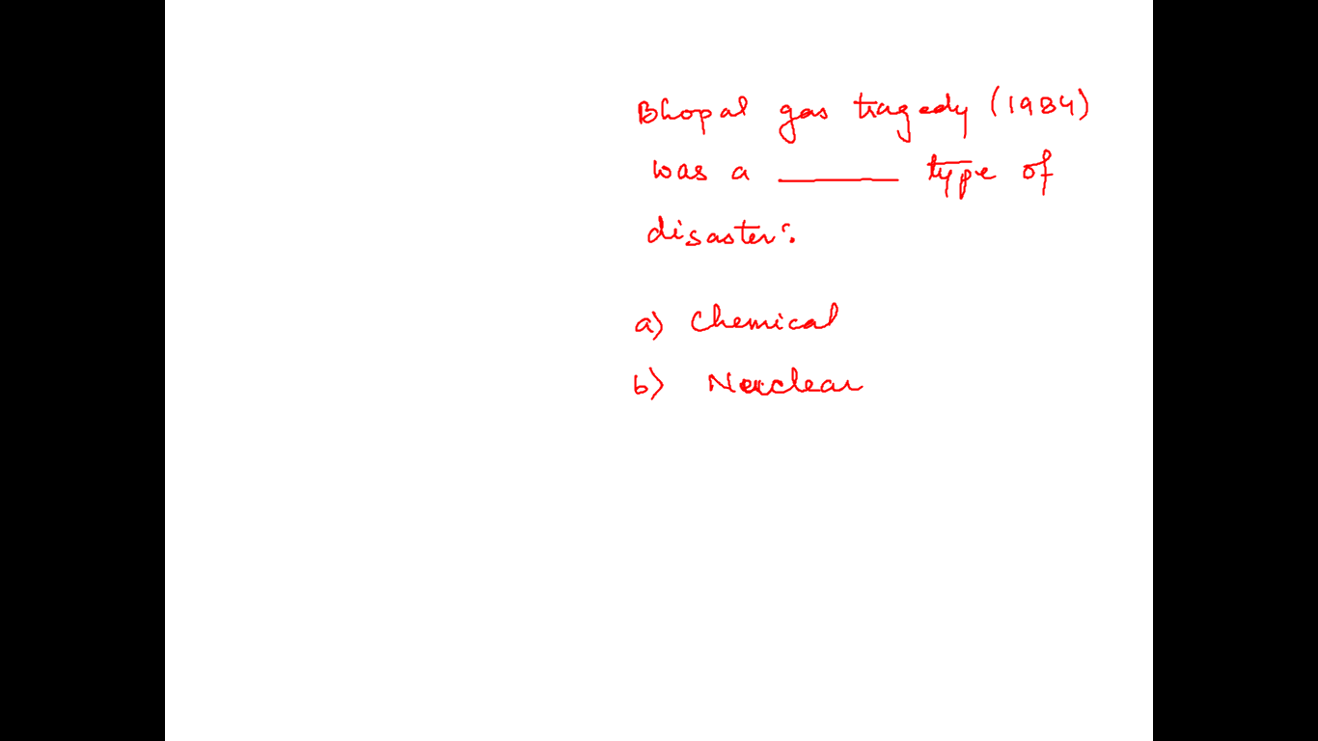

Slide 23
Environmental Acts

Slide 24
Environment Protection Act, 1986
is an Act of the Parliament of India. In the wake of the Bhopal Tragedy, the Government of India enacted the Environment Protection Act of 1986.
The purpose of the Act is to implement the decisions of the United Nations Conference on the Human Environments they relate to the protection and improvement of the human environment and the prevention of hazards to human beings, other living creatures, plants and property.
The Act is an “umbrella” legislation designed to provide a framework for central government coordination of the activities of various central and state authorities established under previous laws, such as the Water Act and the Air Act.

Slide 25
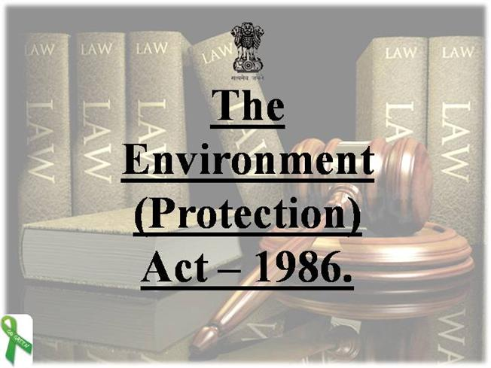
Objectives of the Act
To co-ordinate the activities of the various regulatory agencies already in existence.
Creation of an authority or authorities with adequate powers for environmental protection.
Regulation of discharge of environmental pollutants and handling of hazardous substance.
Encourage industry for recycling and reusing the waste
Speedy response in the event of accidents threatening environment and punishment to those who endanger human environment, safety and health..

Slide 26
Air (Prevention and Control of Pollution) Act, 1981
Bill passed by both the house of parliament received the approval of the President on 29 March 1981.
The objective of this Act is to provide for the prevention, control and abatement of air pollution, for the establishment, with a view to carrying out the aforesaid purposes, of Boards, for conferring on and assigning to such Boards powers and functions relating thereto and for matters connected therewith.
Decisions were taken at the United Nations Conference on the Human Environment held in Stockholm in June 1972, in which India participated, to take appropriate steps for the preservation of the natural resources of the earth, which among other things, includes the preservation of the quality of air and control of air pollution.
Therefore it is considered necessary to implement the decisions aforesaid insofar as they relate to the preservation of the quality of air and control of air pollution.

Slide 27
Water (Prevention and Control of Pollution) Act 1974
Act come into force on 23 March 1974.
Amended in year 1978 & 1988
Chapter and 64 sections
Objective
to prevent , control and maintenance or restoration of wholesomeness of water.
Provisions of the Act has to be implemented by Central Pollution Control Board being a main agency.
Functions-
Establishes standards of the water quality and effluent
Polluting industries must seek the permission to discharge the waste into effluent bodies.

Slide 28
Wildlife Protection Act of 1972
Comes in existence on 9 December 1972 (Except J&K)
Amended in year 1982 & 1986
Wildlife protection Act of 1972 defines wildlife to include any bird or animal and aquatic or land vegetation, form part of any habitat.
Wildlife protection Act of 1972 provide the protection of birds and animals and for all matters that are connected to it whether it be their habitat or the waterhole or the forest thast sustain them.
Task of setting up National parks and sanctuaries and central zoo authorities.
Appointment of wildlife advisory board, warden, their power and duties
Listing and protection of endangered species
Prohibition of illegal trade and commerce of wild life species but allow with license.
Captive breeding program

Slide 29
The Convention on Biological Diversity (CBD),
The variability among living organism from all sources/ecosystem and ecological complexes of which they are a part.
known informally as the Biodiversity Convention, is a multilateral treaty. The Convention has three main goals:
conservation of biological diversity (or biodiversity)
sustainable use of its components
fair and equitable sharing of benefits arising from genetic resources
The Convention was opened for signature at the Earth Summit in Rio de Janeiro on 5 June 1992 and entered into force on 29 December 1993.
2010 was the International Year of Biodiversity.
UN declared the period from 2011 to 2020 as the UN Decade on Biodiversity.

Slide 30
Unit VI
Human Communities and Environment

Slide 31
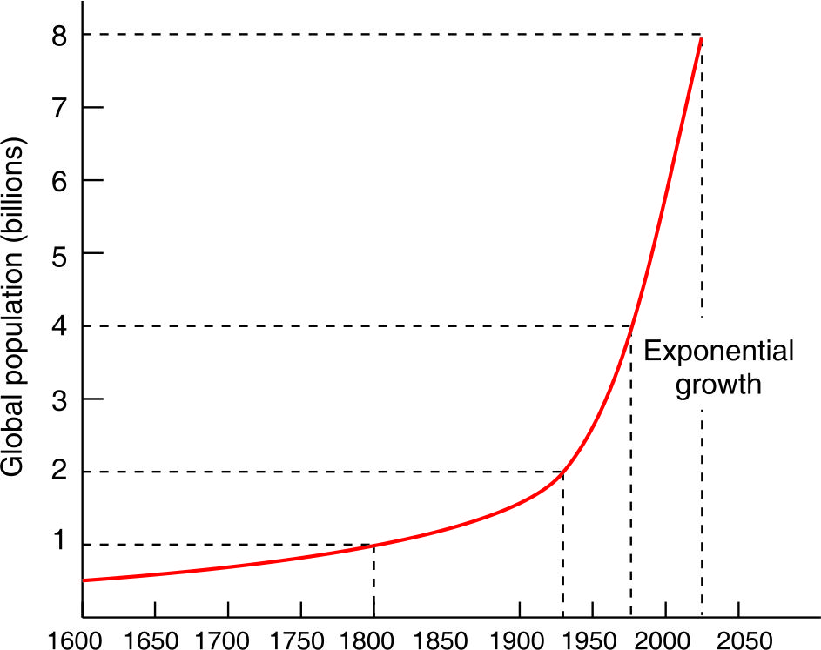
Human Population Growth
Population growth was slow and stable till 1900, but a dramatic exponential growth occurred after 1930’s following technological growth.
Global population growth trends in the last four centuries

Slide 32

Causes of Population Growth
Conquest of diseases: Availability of cure for many life-threatening diseases
Total fertility rate (TFR)
Infant mortality rate
Replacement level
Poverty
Preference for sons
Custom of early marriages
Improvement in public health and sanitation
Illiteracy: no access for family planning

Slide 33
Effects of population explosion on environment, Human Health & Welfare
severe resource depletion and environmental degradation.
Limited resources like land, water, fossil fuels, minerals etc. are getting exhausted.
renewable resources like forests, grasslands etc. are under tremendous pressure.
Industrial and economic growth are raising our quality of life but adding toxic pollutants into the air, water and soil.
Ecological life-support systems are getting jeopardized.
• Human health is influenced by many factors like nutritional, biological, chemical or psychological, which are related to environment.
• Infectious organisms: Disease-causing organisms pose greater environmental threats to health, more severely in the developing countries especially the tropical ones.
• Microbes can cause food poisoning by producing toxins in the contaminated food. Some moulds grow on food and produce poisonous toxins.
• Infectious organisms can cause respiratory diseases (pneumonia, tuberculosis, influenza etc.) and gastrointestinal diseases (diarrhoea, dysentery, cholera etc.).

Slide 34


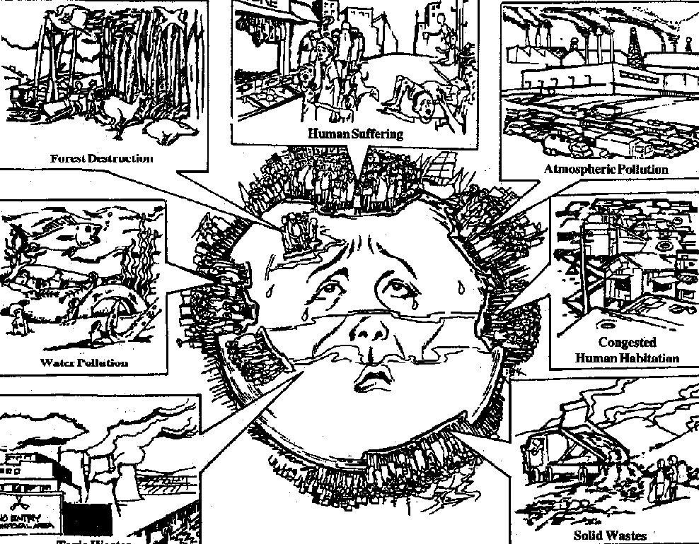
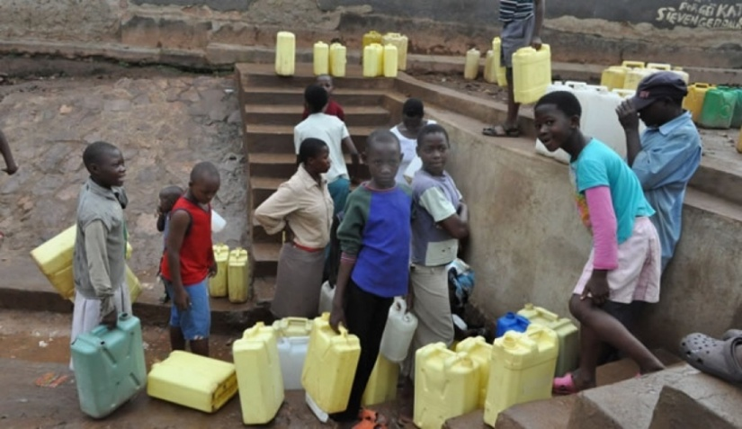
Effects of Population Growth
Excessive exploitation of natural resources
Unemployment
Lack of proper health and sanitation facilities
Environmental pollution

Slide 35
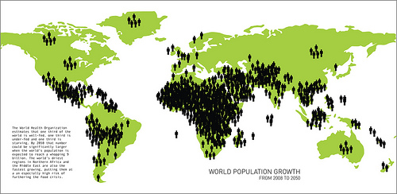
Factors Affecting Variation of Population
Age of human settlement
Availability of means of transport and communication
Type of soil
Climatic conditions
Natural resources

Slide 36
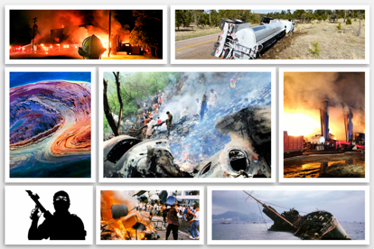
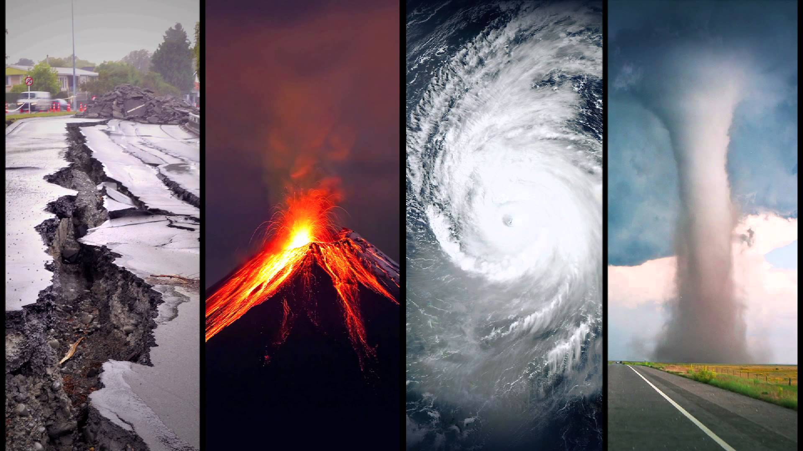
Disaster Management
Natural disaster :
Air-related disasters: Hurricanes, cyclones, storms
Water related disasters: Flood, droughts
Earth related disasters: Earthquake, landslides, volcanoes
Anthropogenic disaster :
Industrial accidents
War, riots, terrorism
Toxic spills
Accidents

Slide 37
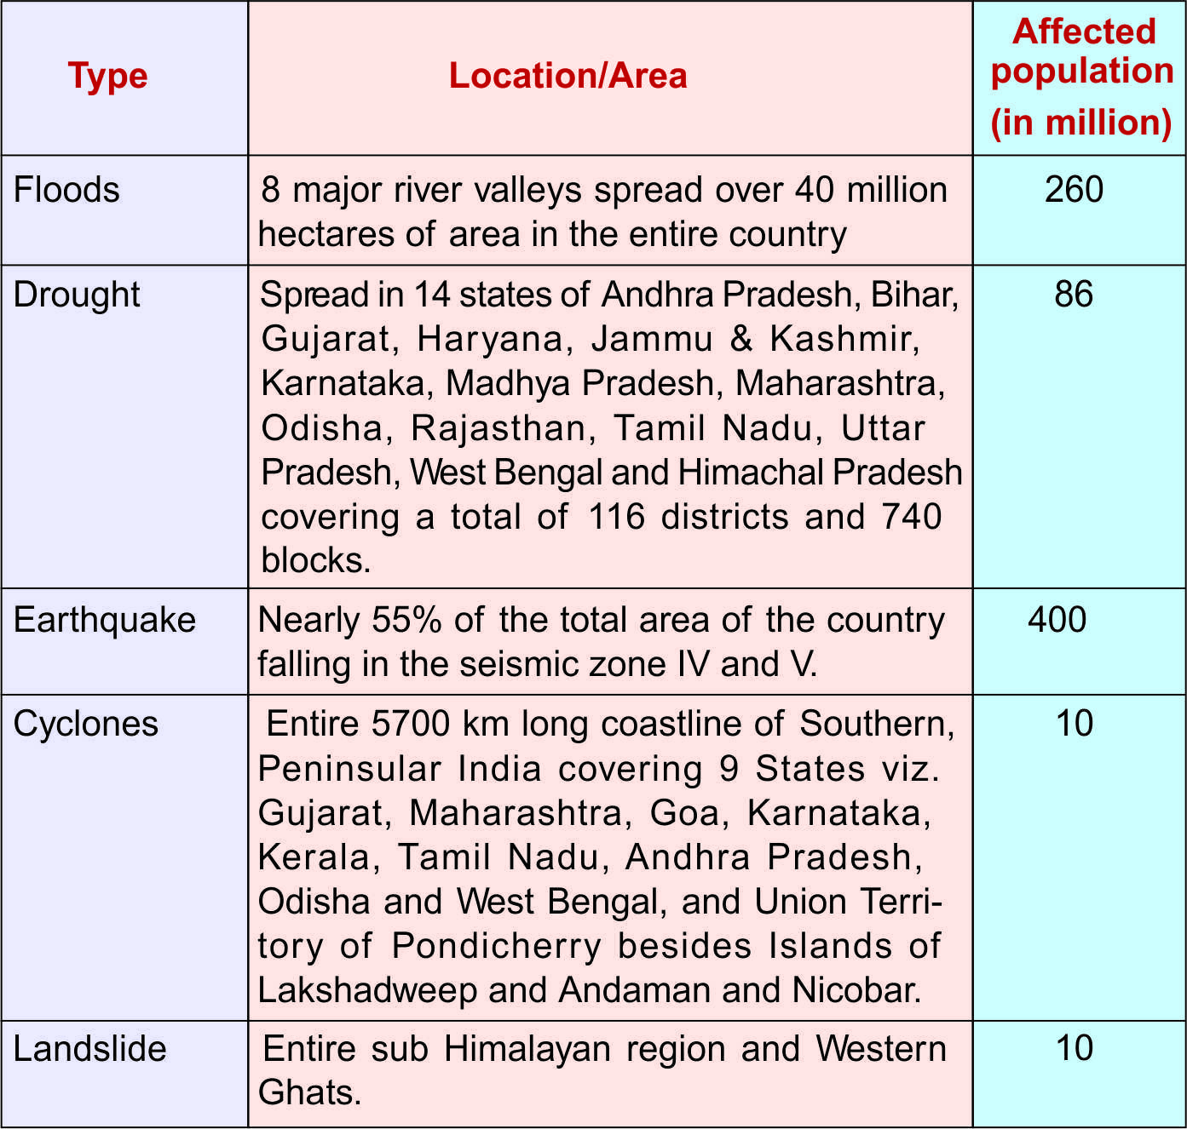

Slide 38
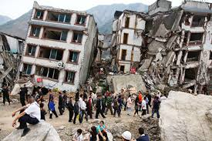
Earthquake
Strong: greater than 5.5, Destructive: >6.2, Disastrous: >7, Catastrophic: >8.1
Causes:
Sudden movement of hot gases and magma
Underground nuclear tests
Volcanic activities
Stress caused by water pressure in dams
Deep well disposal of liquid waste
Tectonic stress generated by movement of tectonic plates
Effect:
Destruction and demolition
Loss of human life
Increase incident of fire and landslides
Tsunami

Slide 39
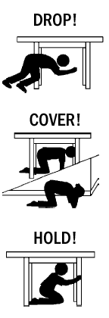

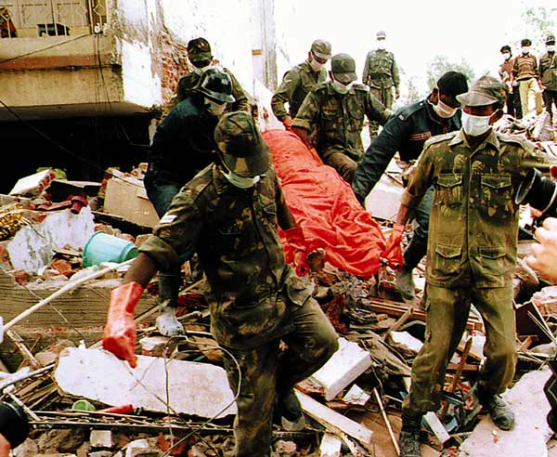
Management:
Earthquake prone area should be recognized, appropriately designed building
Appropriate relief measure
Awareness

Slide 40
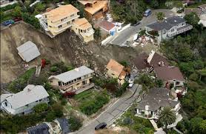
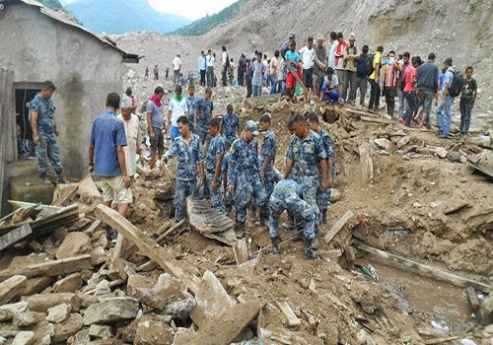
Landslides
Causes:
Natural cause:
Earthquake
Volcanoes
Torrential rains and glaciers
Anthropogenic cause:
Dam, bridges, tunnels, roads
Mining, use of explosive
Destruction of vegetation
Effects:
Debris
Damage buildings
flood
damage crop and agriculture
Management:
Remote sensing technique
Right construction
Regulating flow of water
Relief measure

Slide 41
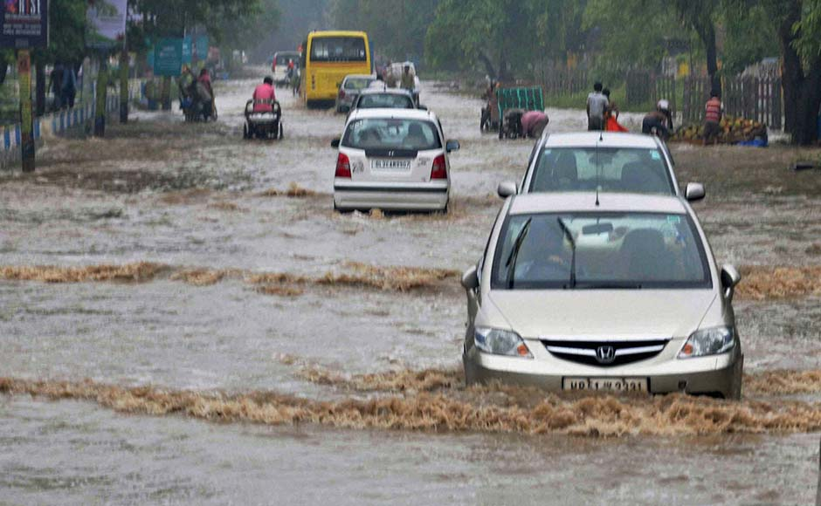
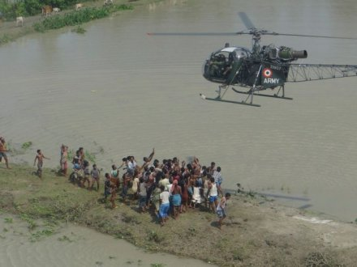
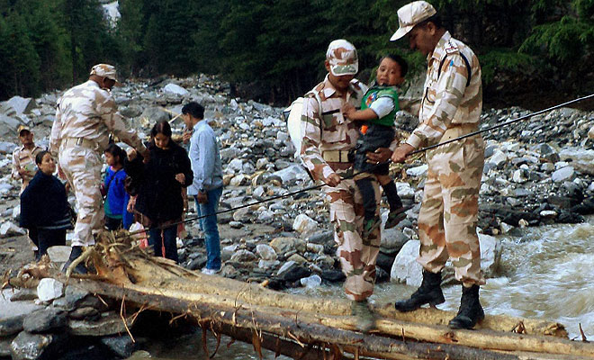
Floods
Types:
Flash flood
River flood
Coastal flood
causes:
Deforestation
Urbanization
Change in river course
Riparian Dams
Man made impediments in river channels
Uncertainty of rain
Effects:
Crop damage
Life and property loss
Disturbance in transportation
increased chances of diseases
Loss of biodiversity
Economic crisis
Management:
Plantation on slopes
Drainage management
Flood plain zoning
Forecasting

Slide 42
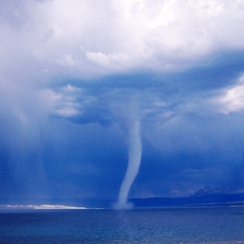
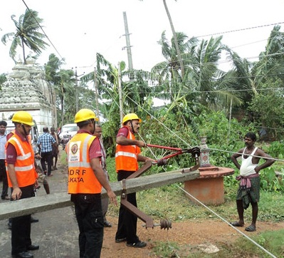
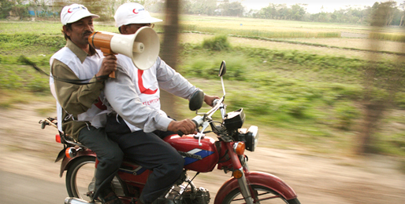
Cyclones
Anti-cyclone
Storm surge
causes:
Low atmospheric pressure region surrounded by winds moving in anti clock direction
Effects:
Effects on the low lying region of coast
Loss of life and property
heavy and prolonged rain
Flood and coastal inundation
Management:
Forecasting
Construction care
Relief task
Dissemination of warning

Slide 43
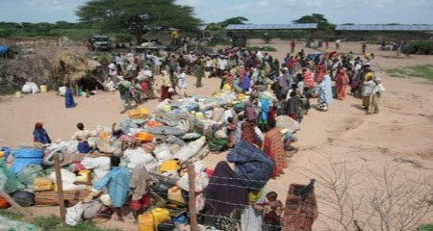
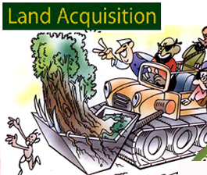
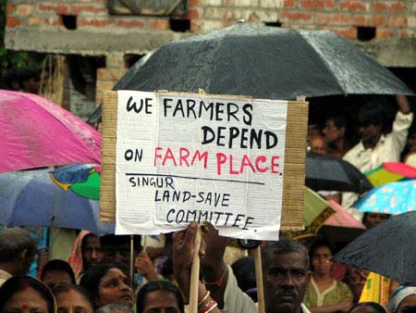
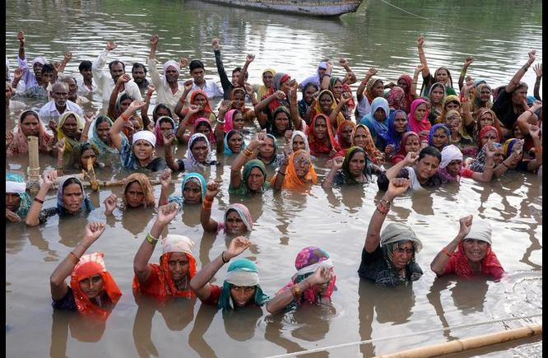
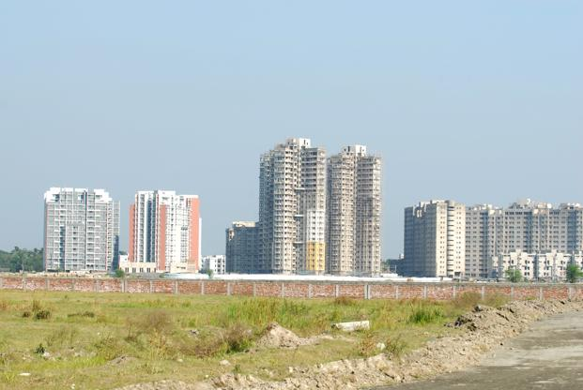
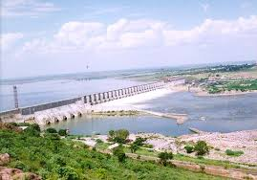
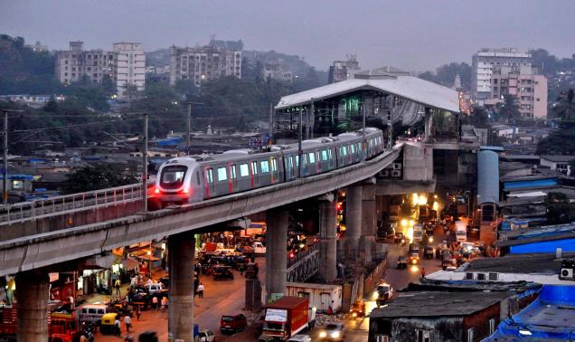

Resettlement and rehabilitation of people: problems and concern

Slide 44



Environmental ethics: Issues and possible solutions
Utilitarian Justification: Individualistic ethics
Ecological Justification: normal justification: Environmental fascism

Slide 45

Human Communities and the Environment

Slide 46


Chipko Movement
Primarily a forest conservation movement in India that began in 1973 and went on to become a rallying point for many future environmental movements all over the world; it created a precedent for non-violent protest started in Uttarakhand, India.
In 1987, the Chipko Movement was awarded the Right Livelihood Award. Male and female activists played vital roles, including Gaura Devi, Sudesha Devi, Bachni Devi and Chandi Prasad Bhatt.

Slide 47


Silent valley Movement
Silent Valley National Park is located in the Nilgiri Hills, Mannarkkad, Kerala.
Plans for a hydroelectric project that threatened the park's rich wildlife stimulated an environmentalist social movement in the 1970s, known as the Save Silent Valley movement, which resulted in cancellation of the project and creation of the park in 1980.

Slide 48
Bisnoi of Rajasthan
Bishnoi (also known as Vishnoi) is a religious group found in the Western Thar Desert and northern states of India.
Khejarli Massacre: Nearly two centuries ago, Amrita Devi, a Bishnoi woman who, along with more than 363 other Bishnois, died saving the Khejarli trees. Maharajah Abhay Singh of Jodhpur required wood for the construction of his new palace, he sent his men to cut trees in the region of Khejarli. But when Amrita Devi and local villagers came to know about it, they opposed the king's men.
The feudal party told her that if she wanted the trees to be spared, she would have to give them money as a bribe. She refused to acknowledge this demand and told them that she would consider it as an act of insult to her religious faith and would rather give away her life to save the green trees. Some Bishnois who were killed protecting the trees were buried in Khejerli village. This is still remembered as the great Khejarli sacrifice.

Slide 49



Public Awareness & Objectives
Identifying endangered species
Decisions regarding the use of natural resources
Conservation of nature and natural resources for the societal benefits
Resolving issues regarding environmental pollution

Slide 50





Methods of Public Awareness
Environmental education
Through Mass Media, print media, broadcast and Internet

Slide 51




Organizing seminar and conferences and campaign

Slide 52





Entertainment
Science centre

Slide 53





Involvement of public figures
Involvement of Youth

